Slide 1
Documentation of Seaspace Ground Station Systems at Elizabeth City State University
Je'aime H. Powell (Mentor)
Derek Morris Jr.
Shahee Jackson
Andrew Brumfield
Glenn Michael Koch

Slide 2
Abstract
On February 7, 2012 a Memorandum of Understanding (MOU) was signed between Elizabeth City State University (ECSU) and Seaspace Corporation. The memorandum lead to the proposed installation of three direct-broadcast satellite receiving ground stations and a training site at ECSU. The receiving stations included a 3.6m X/L band system, a 3.7m C band system, and a 5.0m L band system. The MOU defined that once the installation of the various systems completed, ECSU would in turn provide an east-coast training and data center for Seaspace products. The purpose of this project was to document the installation requirements and internal processes at ECSU for the ground stations, as well as; generate a report of training site physical requirements. Aspects of the MOU including ECSU policy requirements, location engineering findings, location installation requirements, ground station capabilities, and training center needs are addressed.

Slide 3
Introduction and MOU
•SeaSpace Considerations :
•Training
•Equipment
•Software
•Contractual Service

Slide 4
Introduction and MOU
•ECSU Considerations :
•Training
•Equipment
•Software
•Contractual Service

Slide 5
Keywords
Telemetries
Ground Station
Microwave Radio Frequency Bands
Terascan
TeraVision
Notes:
Telemetries- Satellites that receive data
Ground Station- Receive information from telemetries
Radio Frequency Band- Is a part of the electromagnetic spectrum corresponding to the frequencies
TERASCAN-open architecture and script-driven operation give you the power and flexibility to create the processing environment you need.
TeraVision-is the main tool for visualization in the TeraScan software package.

Slide 6
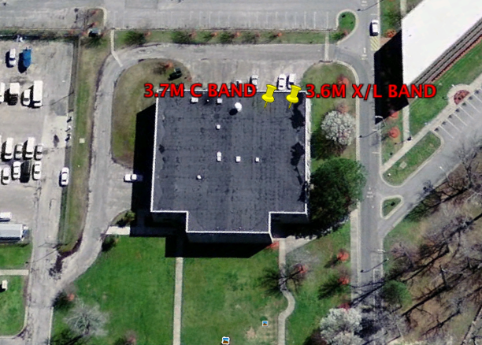
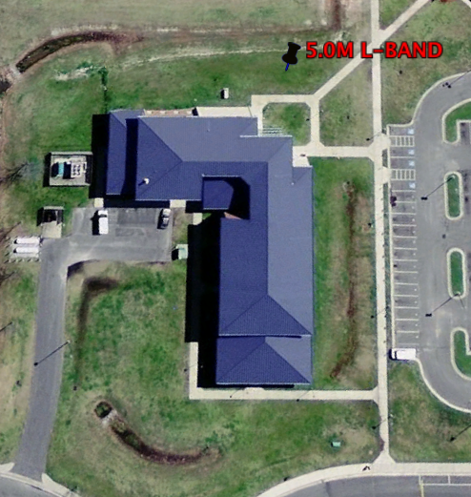
Proposed Location
Dixon Paterson Hall
Information Technology Center

Slide 7
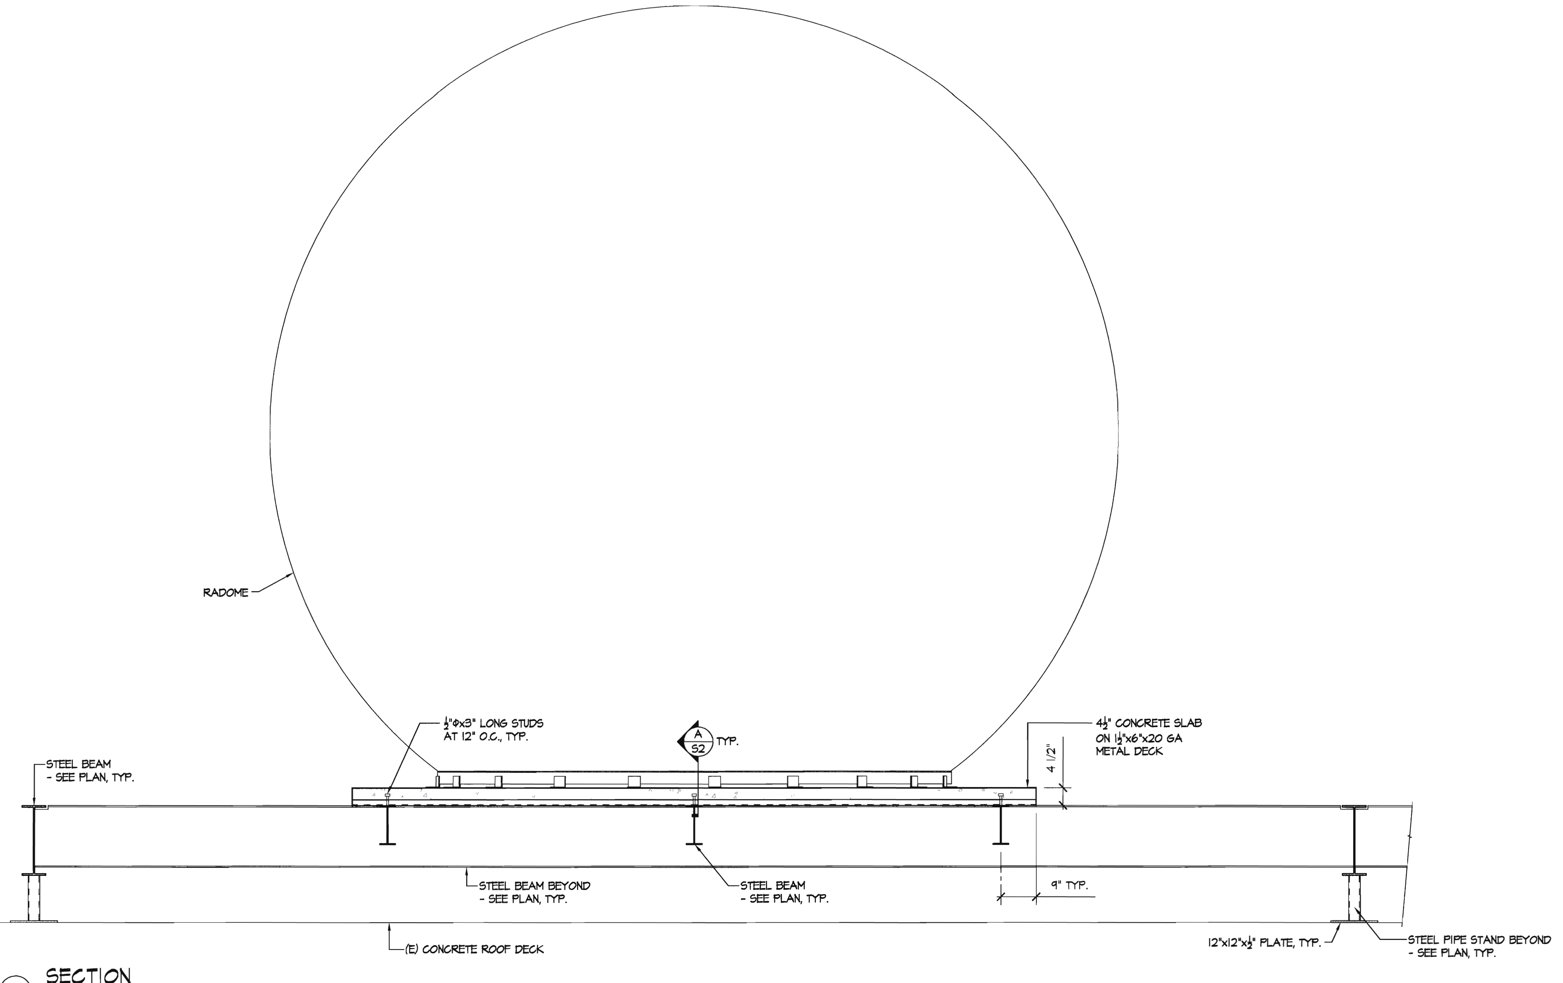
TimeLine
Building Approval Committee
Engineering Report
Rail Design
Conduit Install
Seaspace Subcontractor
ECSU Subcontractors
Training Site

Slide 8
L Band
Frequency range
1-2 GHz
Telemetries
NOAA, METOP
Products
SST
NVDI
AVHRR

Slide 9
X Band
Frequency range
8-12 GHz
Telemetries
NOAA, METOP, OCEANSAT DB
Products
Airplanes
Vehicle Speed Detectors

Slide 10
C Band
Frequency range
4-8 GHz
Telemetries
GOES, HRIT, COMS, MSG
Products
IR
OLR
Notes:
Geostationary- is satellite in a circular equatorial orbit in which it circles the earth once per sidereal day so that it appears stationary in relation to the earth's surface Also geosynchronous

Slide 11
ECSU Training Sites Requirement
PC compatible with Teravision
Scheduled training event
Integrate into ECSU curriculum

Slide 12
Summary
·Ground Station locations were vetted and selected.
·Rail design for rooftop installation was accomplished.
·Subcontractors were proposed for individual tasks.
·Training center assets and liabilities were identified and addressed.
The purpose of our research was to view the overall project and provide a guide for site preparation and installation as well as a record for future exploitation.

